Slide 2
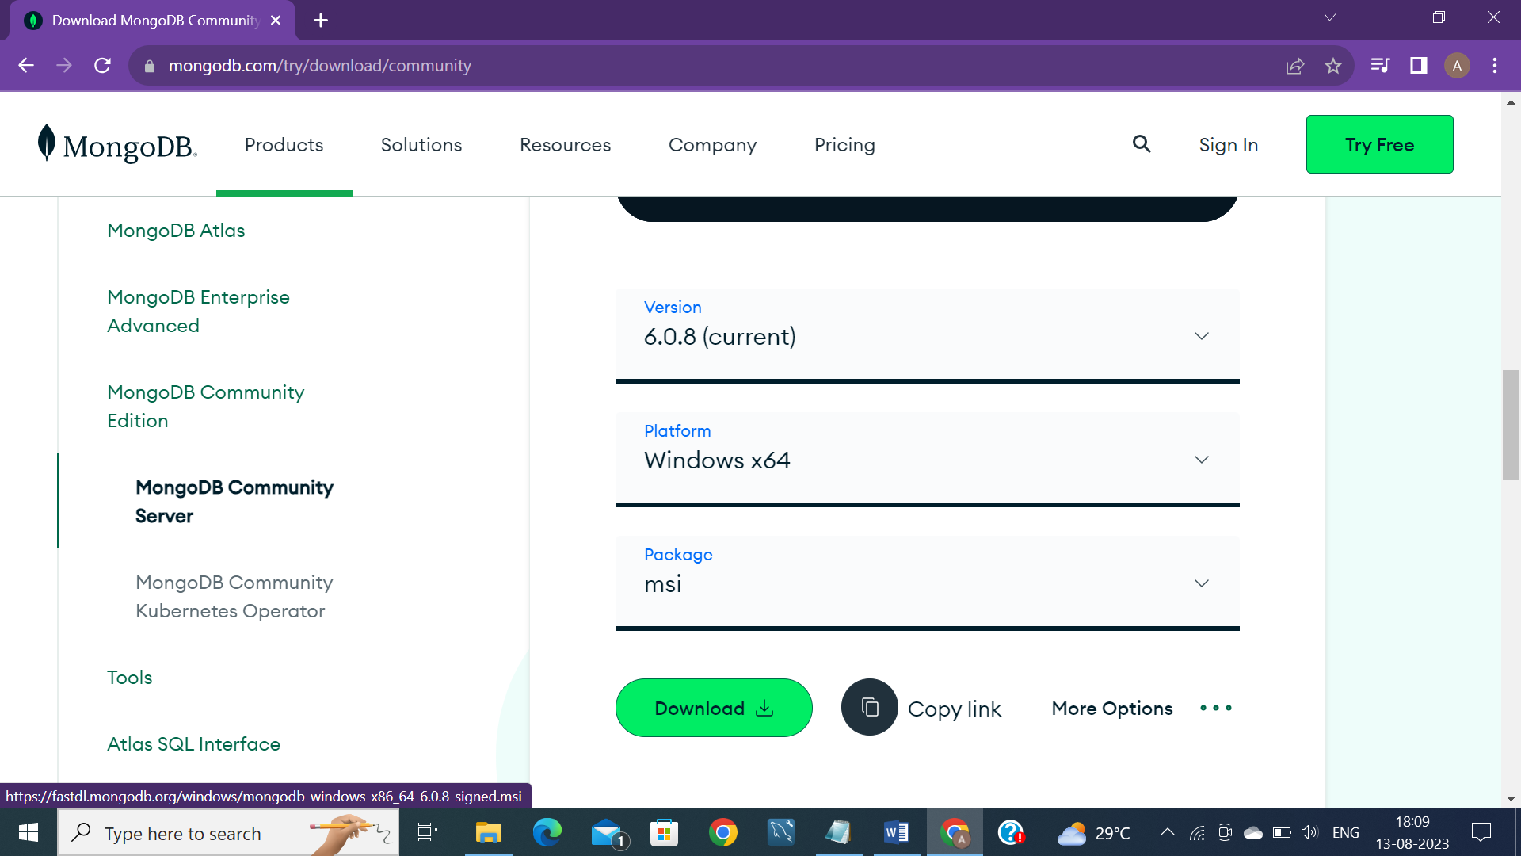

Slide 3
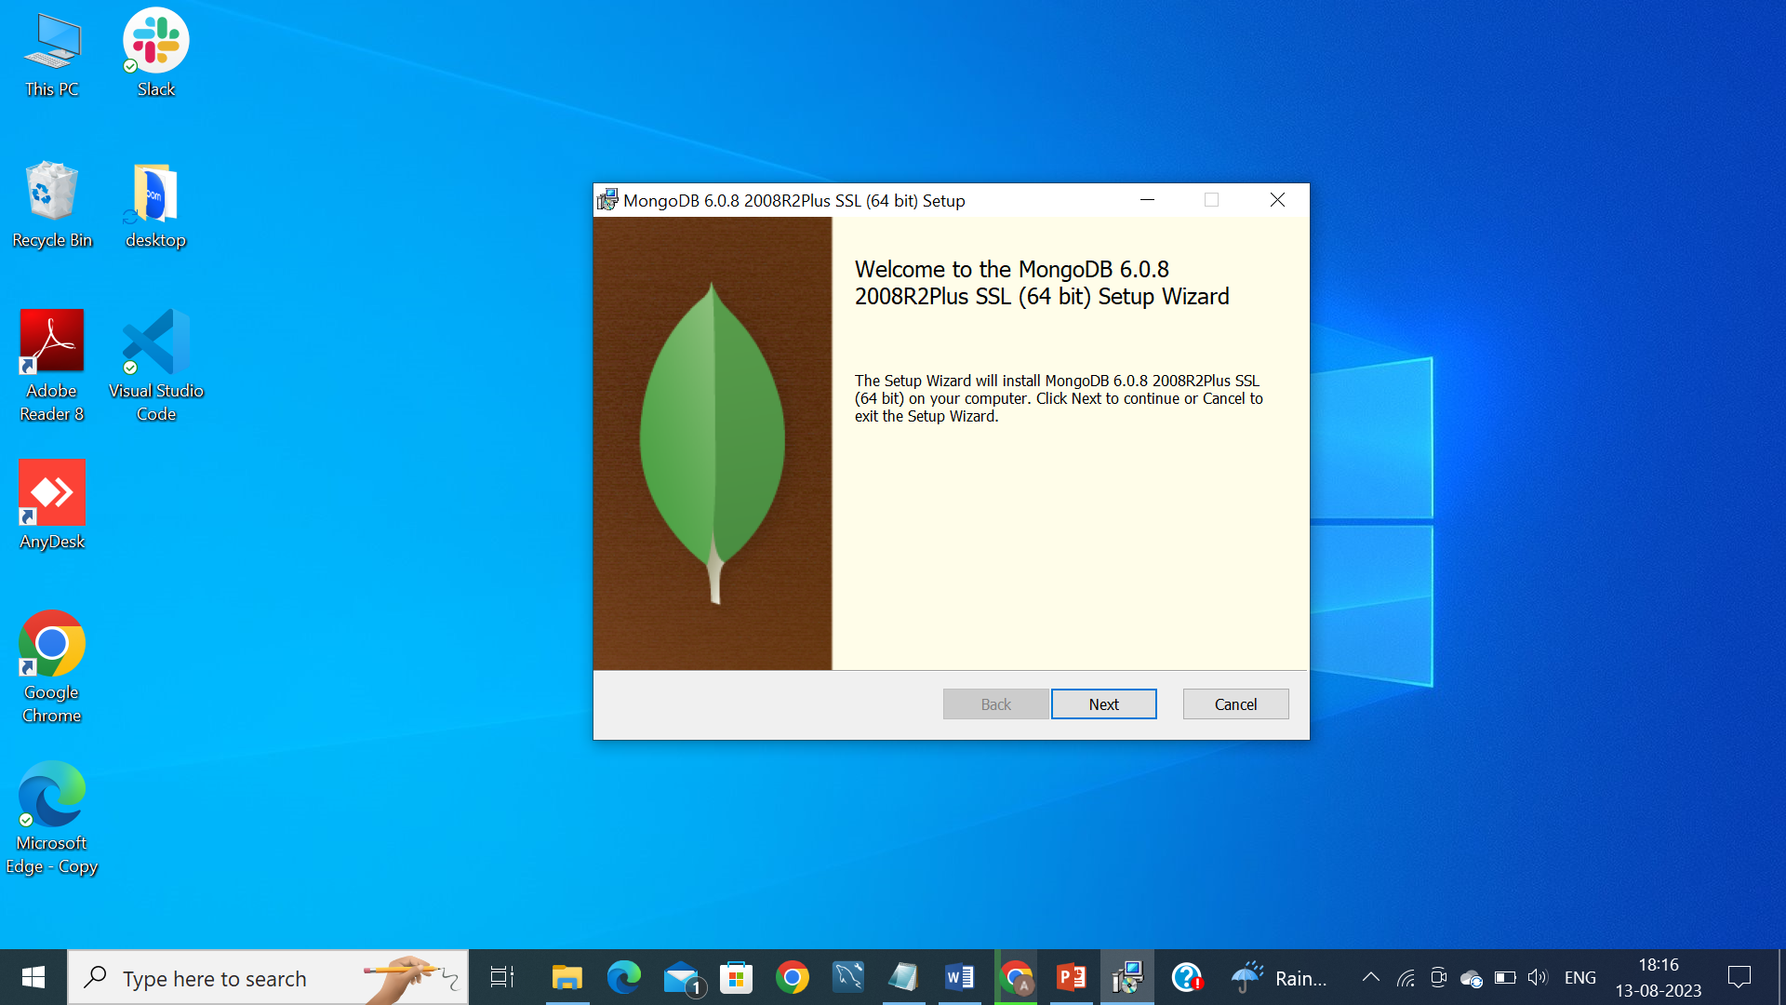

Slide 4
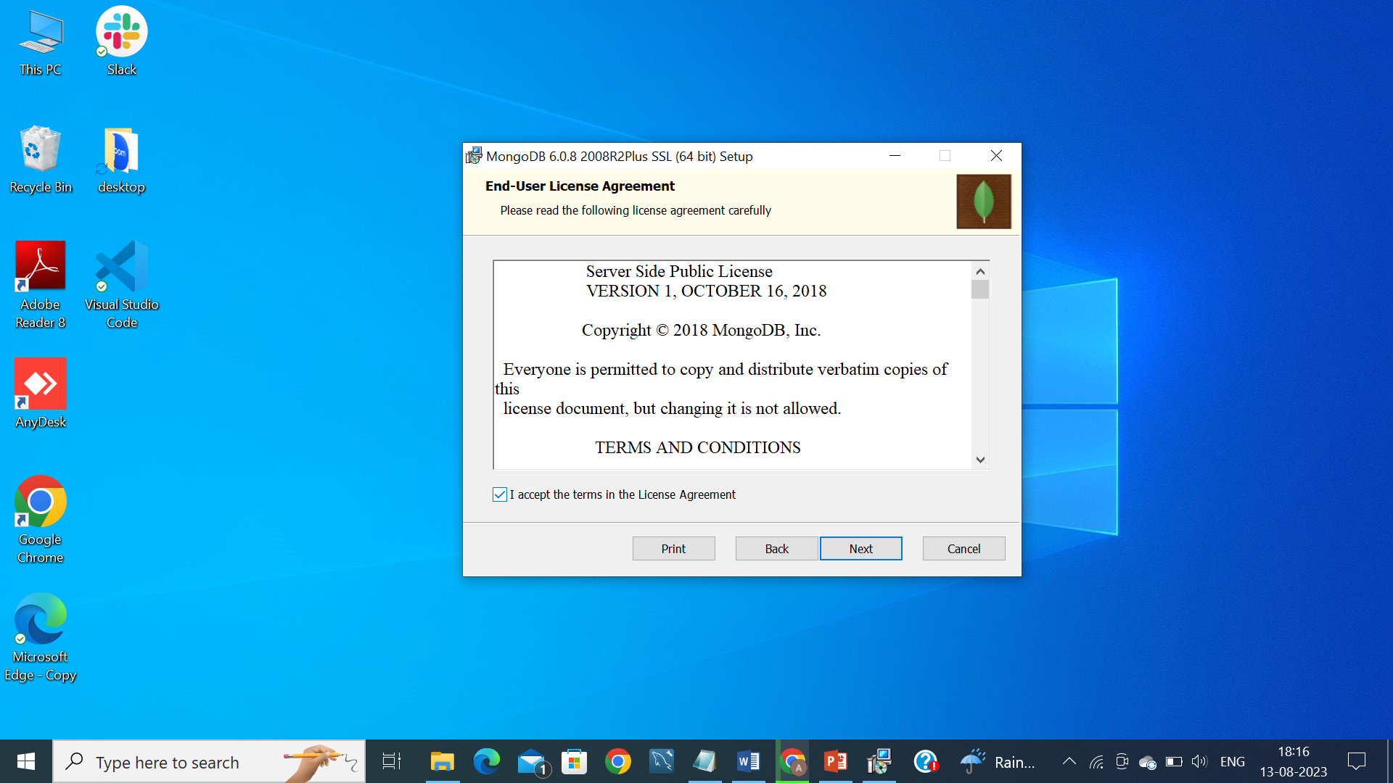

Slide 5
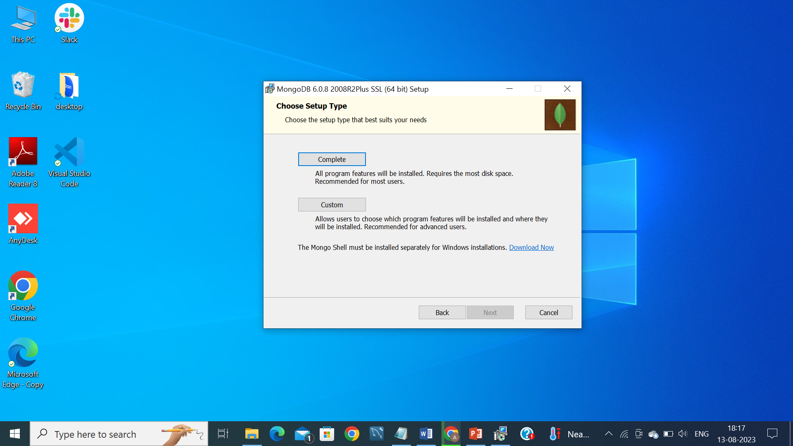

Slide 6
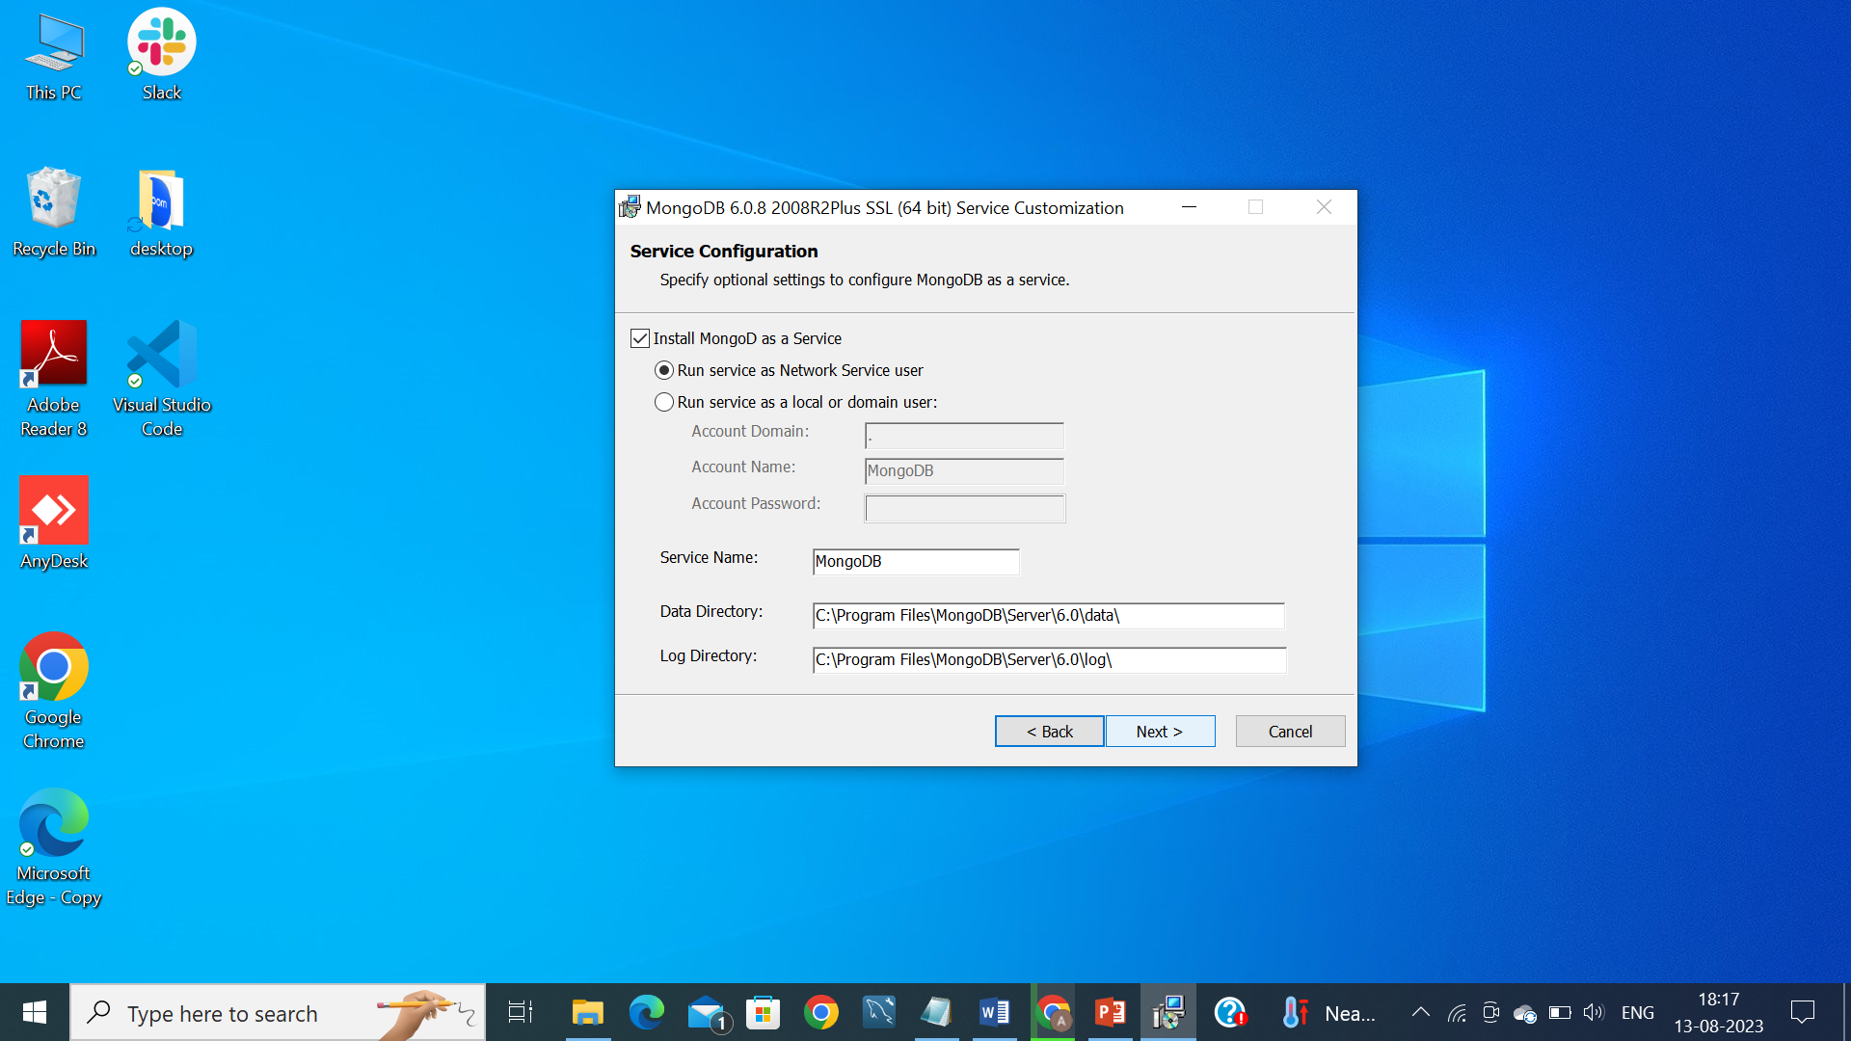

Slide 7
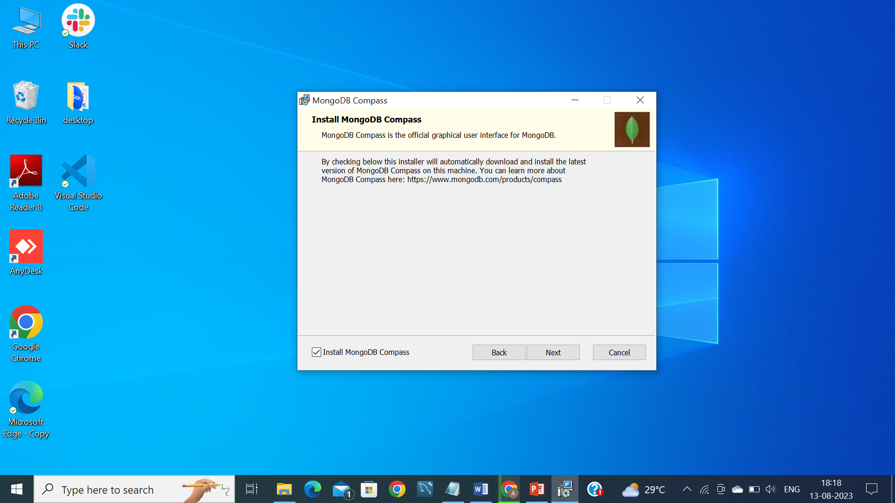

Slide 8


Slide 9


Slide 10


Slide 11


Slide 12
Goto - C drive – create a folder named ‘data’, then create a subfolder named ‘db’ → This is an essential part as all the logs and activities of MongoDB is stored there.
GoTo - C:\Program Files\MongoDB\Server\6.0\bin and open PowerShell window by (shift + right click) – show more options – open a PowerShell window here.(Windows 11)
Type → ./mongod.exe → this will run the MongoDB server instance.
Goto → Start – type mongoDBCompass, connect with the instance ‘mongodb://localhost:27017’

